Slide 1
9.29.14
Announcements/New Seating – 5 minutes
New Vocabulary Game Introduction & Vocabulary Game – 10 minutes
Independent Reading – 15 minutes
Introduction to Gothic Literature Unit – 25 minutes
Notes
Story Vocabulary
“The Minister’s Black Veil” by Nathaniel Hawthorne
Class read
Focus on Symbolism

Slide 2
New Vocabulary Game
We will begin each class period with the game.
Your team will be the your table group for the week.
Rules:
The table with all members of seated and ready for class first receives the first point
Each student will be read one vocabulary word at random. (We will be starting with our literary terms list and adding words as we go on).
If the student correctly defines the word, their team will receive a point.
If the student does not, the teacher will define the word. This process will be repeated until each student has had the chance to define a vocabulary word.
Students MAY also gain or lose points throughout the class period based on behavior that is either on or off task.
The table group with the most points at the end of each week will receive a prize, TBD.
Following the vocabulary game, class will continue with 15 minutes of independent reading time as usual.

Slide 4
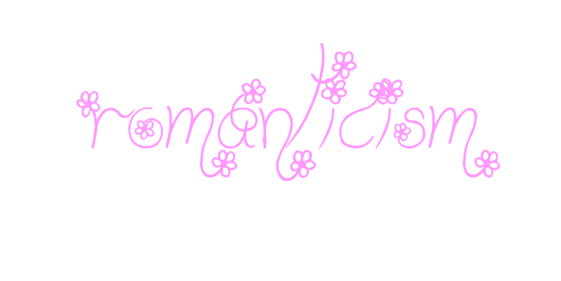
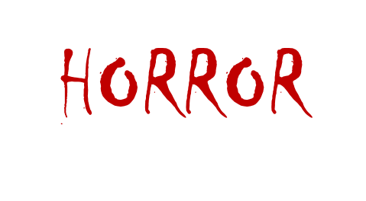
American Gothic Literature
Gothic Literature
A blend of two genres:
Provokes a reaction (fear, etc.)
Strong senses, emotions, & feelings • Element of the supernatural
Awe of nature • Setting and Atmosphere that
Celebration of the Individual promotes isolation, gloom, etc.
Importance of Imagination

Slide 5
American Gothic Literature
Gothic is a genre of literature characterized by the following qualities:
Gloomy settings
The grotesque
Mysterious atmosphere
Violent events
Imagery depicting degeneration and decay
Gothic Literature was initially influenced by art & architecture of the time
Vocabulary:
grotesque- comically or repulsively ugly or distorted
degeneration- decline or deterioration

Slide 6
American Gothic Literature
Gothic Literature was a genre of fiction in Europe before making its way to America
Is thought to have its origins in England
First Gothic story attributed to Horace Walpole in 1764 – The Castle of Otranto
Still is a genre that authors write in today
American Gothic Literature combines Gothic Literature with American ideals

Slide 7
American Gothic Literature
Common Elements in American Gothic Literature include:
Settings most often include large, drafty old houses
Castles were common in European Gothic Literature. In the American landscape castles were practically unheard of, so early Gothic fiction writers began substituting the family estate for the traditional castle.
Atmosphere of mystery and suspense
Highly charged emotional states: terror, insanity, anger, agitation, anxiety, depression, and obsessive love

Slide 8
American Gothic Literature
Common Elements in American Gothic Literature include:
The Supernatural: Ghosts or ghostly legends, unexplainable occurrences or sounds, etc.
Foreshadowing: Through the use of omens, dreams, etc.
Damsels in distress: women who are frightened/confused, wandering around lost, or dying due to a slow and unexplainable ailment
Romantic themes often involving the death of a man or woman in the throes of great passion, the obsessive nature of a man or woman in love, or excessive grief one feels upon the loss of a loved one.

Slide 9
American Gothic Literature
Southern Gothic Literature is a subgenre of American Gothic Literature and has some unique elements of its own:
Usually uses macabre (gruesome or horrifying) irony - so the stories are usually darkly humorous
Used as a form of social critique of Southern society
Gothic elements such as the supernatural and elements of suspense are used to reveal cultural character rather than just for entertainment value

Slide 10
American Gothic Literature
“The Minister’s Black Veil”
symbolism – an object, event, idea, etc. that represents something else, giving deeper and more significant meaning than the literal
Examples:
A Rose is a symbol for Love *Can you think of an
A Dove is a symbol for Peace example from F451?
Black is a symbol for Evil or Death

Slide 11
American Gothic Literature
“The Minister’s Black Veil”
Vocabulary:
Sexton – a person who looks after a church and/or churchyard
Venerable – given a great deal of respect because of age, wisdom, or character
Countenance – a person’s face or facial expression
Iniquity – immoral or grossly unfair behavior
Melancholy – a feeling of pensive sadness
Indecorous – improper
Sagacious – wise, clever; showing good judgment
Aghast – filled with horror or shock

Slide 12
American Gothic Literature
“The Minister’s Black Veil”
Vocabulary:
Placid – calm
Impertinent – not showing proper respect; rude
Portend – an omen or sign that something important is going to happen
Perceive – become aware or conscious of; come to realize or understand
Affliction – something that causes pain or suffering
Obstinate – stubborn
Antipathy – deep-seated feeling of dislike; aversion
Obscurity – unknown, inconspicuous, mysterious

Slide 13
9.30.14
Announcements – 5 minutes
New Vocabulary Game: Review Rules & Play – 10 minutes
Independent Reading – 15 minutes
“The Minister’s Black Veil” by Nathaniel Hawthorne– 30 minutes
Focus on Symbolism

Slide 14
American Gothic Literature
“The Minister’s Black Veil”
As a class, we will be reading “The Minister’s Black Veil,” by Nathaniel Hawthorne
While you read, look/listen for examples of symbolism
Write these examples of symbolism down on a separate sheet of paper, along with what you believe each symbol represents. This will be your Ticket out the Door.

Slide 15
American Gothic Literature
“The Minister’s Black Veil”
Question:
The audience reacts to the minister's words and appearance. Do you think the minister planned to have this effect? Find evidence in the text to support your answer.

Slide 16
American Gothic Literature
“The Minister’s Black Veil”
Question:
The minister sometimes refers to a "veil" over others' faces. To what veil do you believe he is referring? Find evidence in the text to support your answer.

Slide 17
10.02.14
Announcements – 5 minutes
Vocabulary Game – 10 minutes
Independent Reading – 15 minutes
“The Minister’s Black Veil” by Nathaniel Hawthorne
Review Reading from Tuesday – 5 minutes
Continue Reading as a Class
Focus on symbolism

Slide 18
American Gothic Literature
“The Minister’s Black Veil”
Do Now:
In complete sentences, summarize “The Minister’s
Black Veil” up to the point where we stopped.
What – if anything – is the minister’s reason for
wearing the veil? What do you believe is going to
happen in the story?

Slide 19
American Gothic Literature
“The Minister’s Black Veil”
Question:
Why do you believe no one in the town ever asks the minister about why he wears the veil?

Slide 20
American Gothic Literature
“The Minister’s Black Veil”
Question:
In what ways does the veil effect the minister's life? Find evidence from the text to support your response.
Do you think the veil makes the minister better at his job?

Slide 21
American Gothic Literature
“The Minister’s Black Veil”
Question:
Hawthorne calls the human heart "the loneliest prison." What does he mean by this?

Slide 22
American Gothic Literature
“The Minister’s Black Veil”
The minister’s veil is a symbol that is used throughout this story. Find two examples from the story and explain in complete sentences how the symbol is used to advance the story.

Slide 23
10.03.14
Announcements – 5 minutes
Vocabulary Game – 10 minutes
Independent Reading – 15 minutes
“A Rose for Emily” by William Faulkner
Introduction & Notes – 10 minutes
Group Read at Tables – remainder of class period
Focus on foreshadowing

Slide 24
10.06.14
Announcements – 5 minutes
Vocabulary Game – 10 minutes
Independent Reading – 15 minutes
“A Rose for Emily” by William Faulkner
Review reading from Friday– 5 minutes
Group Read at Tables – 15-20 minutes
Focus on foreshadowing: activity/video – remainder of period

Slide 25
10.27.14 ~ 10.30.14
Announcements – 5 minutes
Vocabulary Game – 10 minutes
Independent Reading – 15 minutes
American Gothic Short Story Mini Project
Explain Assignment
Remainder of time groups may begin reading their stories

