Slide 1
the perks of being a wallflower
STEPHEN CHBOSKY

Slide 2
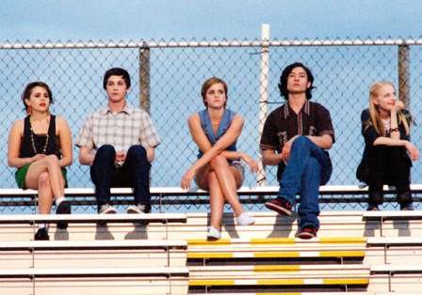
Setting:
There are a couple of main settings and some minor settings
Pennsylvania
Years: 1991 and 1992
Big Boy
High School
Characters’ Houses

Slide 3
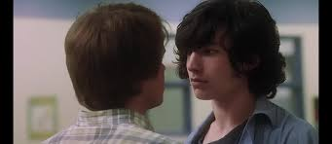
Conflict(s)
Internal:
Charlie has to deal with his emotions
Charlie and Mary Elizabeth
Charlie trying to fit in
External:
Brad and Patrick
Charlie and Aunt Helen

Slide 4
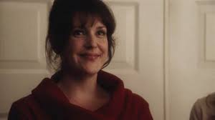
Protagonist and Antagonist
Charlie:
Compassionate
Reserved
Observative
Aunt Helen:
Alcoholic
Depressed
Caring

Slide 5
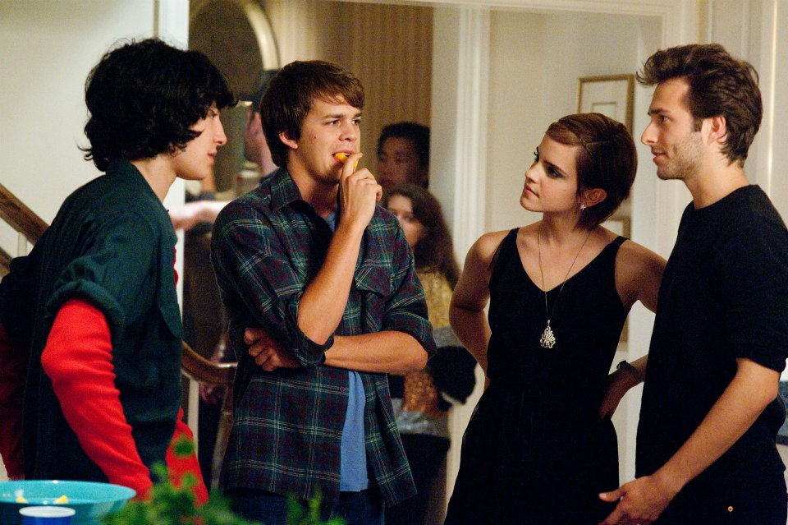
Theme
Sometimes people will feel meaningless or alone, but in actuality they’re surrounded by people who care about them
Someone could pretend to be brave, strong, or even careless, but people need others to help them deal with their pain
People should make the most of their teenage years

Slide 6
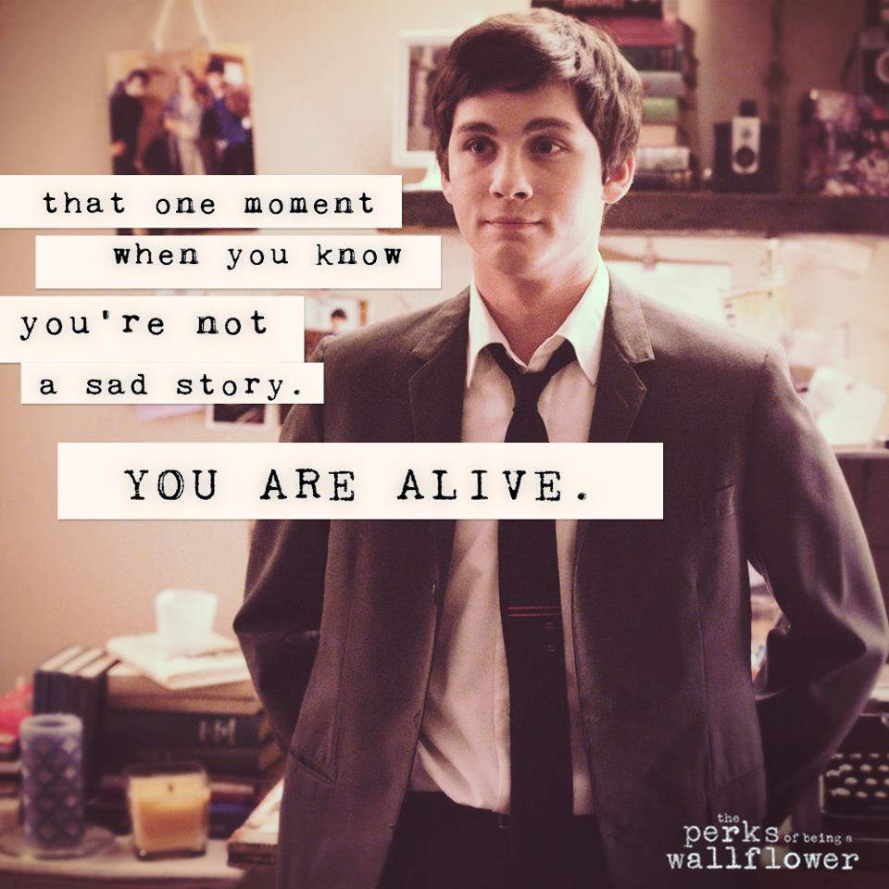
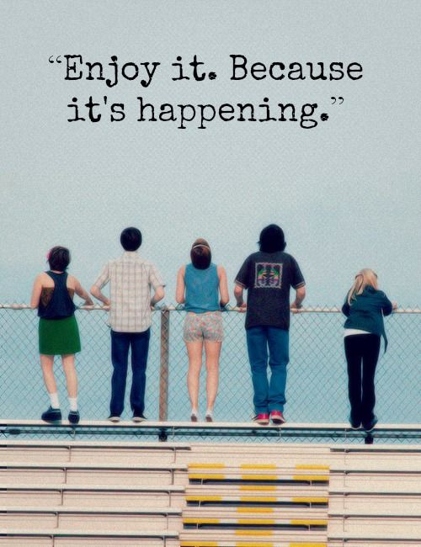
Memorable Quotes
“We accept the love we think we deserve” (pg.24)
“Sometimes people use thought to not participate in life” (pg.24)
“We can’t choose where we come from, but we can choose where we go from there” (pg.211)
“Things change, friends leave, and life doesn’t stop for anybody” (pg.145)
“We are who we are for a lot of reasons and maybe we’ll never know most of them” (pg.211)
“You can’t just sit there and put everybody’s lives ahead of yours and think that counts as love” (pg.200)

Slide 7
Plot
Charlie is a teenage boy starting his first year of high school without his best friend Michael. Charlie then meets a group of seniors who befriend him and help him come out of his introverted shell. The book is about first dates, family dramas, new friends, sex, drugs, and the good and bad days of being a teenager.

Slide 8
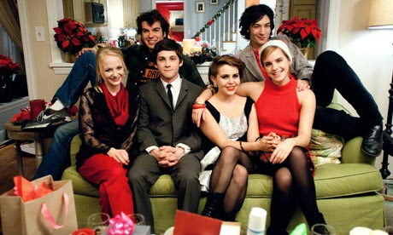
Connections
It’s like the Catcher and the Rye
Connection to society
Connection to myself

Slide 9
Book Review
It is a intriguing tale that captures all of the aspects of high school life. I definitely recommend this book because of the meanings behind it and it is a thrilling tale.

Slide 10
Citations Page
“The Perks Of Being A Wallflower”. Fanpop.com. Fanpop Inc. 2006-2014. Website. October 13, 2014
Watsonuncensored. “Emma Watson in the Perks of Being a Wallflower”. Blogspoot.com. Blogspot Inc. October 11,2012. Website. October 13, 2014
“Gallery”. perks-of-being-a-wallflower.com. Summit Entertainment, LLC. 2012. Website. October 13, 2014
Popcornaddict. “The Perks Of Being A Wallflower (2012)”. Popcornaddiction.com. WordPress. October 5, 2014. Website. October 13, 2014
Lola. “The Perks of Being a Wallflower”. Blogspot.com. Blogspot Inc. 2012. Website. October 13, 2014
“Charlie”. Perksofbeingawallflower.wikia.com. Wikia Entertainment. Website. October 13, 2014
Alex Withrow. “And so it begins”. Blogspot.com. Blogspot Inc. May 22, 2013. Website. October 13, 2014
“Perks of Being a Wallflower Quotes”. Quotes-kid.com. Disqus. 2012. Website. October 13, 2014
Kim Brooks, Kristin Bailey, Kris Kennedy. “The Perks of Being a Wallflower”. Books.simonandshuster.com. Simon & Schuster UK. September 2012. Website. October 13, 2014
“The Perks of Being a Wallflower”. Wikipedia.com. Wikipedia. October 13, 2014. Website. October 13, 2014
“The perks of being a wallflower cover”. Wikia.com. Wikia Entertainment. Website. October 13, 2014

