Slide 1
The Rabbit Proof Fence

Slide 2
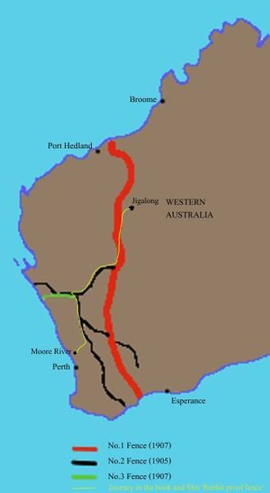
Setting
The Rabbit Proof Fence is an Australian book that is based on a true story of the greatest walking journey of 2400km (1500) miles.
It is also about a rabbit proof fence that covers Western Australia from the north to the south.

Slide 3
Conflict (Internal)
the conflict in the true Journey of(Follow the Rabbit Proof Fence) by Doris Pilkington and Nugi Garimara is that Aborigines children that were taken away from their parents and taught to be like whites so they could become well mannered.
The Aborigines were the native tribe of Australia “ The Aboriginal name that was given to them was Yowada”(31 PILKINGTON) .
This story talks about the three kids Molly, Daisy and Gracie. They were also captured and taken by the whites. When they got there, they missed their home. They had thoughts about how there family will be when they are away.

Slide 4
Conflict (external)
When night arrived all three of them escaped. When they reached at some distance they found fence that was called the rabbit proof fence. It was along fence and covered western half of Australia. Molly decided to follow the fence and then the longest foot journey started. Molly, Daisy and Gracie escaped by the camp but then they faced another danger. That was posters everywhere saying to capture these three girls.
They also starved in the middle of the desert and it was full sunny. “They packed enough food to last them four days: first they would have to walk east until they reached the rabbit-proof fence then once they found the fence it would be a matter for another two days. Next, they walked and they reunited with those who had escaped the camp before”(27 PILKINGTON). The hot and the thirst didn’t let them walk but they followed the fence and journeyed about 1400 miles covering the fence of western Australia to reach their family. Molly did not let Gracie and Daisy go back because if they went back then they would never see their families again.

Slide 5
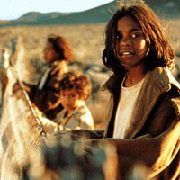
Protagonist
The protagonist in this story was Molly. Molly was the oldest of the three girls.
From the beginning of the story Molly learned a lot.
The one thing that she learned during the story is knowing all the dangers around and love for her family. She learned about the dangers by the struggles she faced during her journey of the Rabbit Proof Fence.
She learned to love her family when the three sisters were taken by the whites. She also missed her family and she is a static character because her love for her family was the same throughout the story.

Slide 6
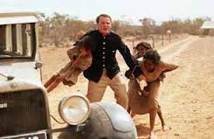
Antagonist
The antagonist in this story were the Australians whites.
They were the one ordered to take the aborigines' children's away so they can be taught to live the life of the whites.
The whites did change in the story. They changed because in the start of the story they wanted to change all the aborigines kids By the end of the story, they knew that they could not have taken all of the aborigines so they stopped.
This was because of the conflict in the story and how they were not able to catch those three children's.

Slide 7
Theme
The message of this story is that one should never give up.
This message was described by all three of the half-caste girls; Molly, Daisy, and Gracie. They walked 1500 miles but never gave up on their journey even though they had to face many struggles like starvation and sickness.
Molly, the oldest of all of them had the most credit in the story because when Gracie fell in the desert, Molly never gave up and carried her all the way back home. Even with this much trouble, she never gave up on the journey of the rabbit proof fence.

Slide 8
Memorable Quotes
(1) “areas north of Perth was occupied by white settlers.” (18 Pilkingto) This expansions brought many changes – settlements inevitably became towns and soon all available arable land in the south-west and the coastal n) This quote portrays to me the settlements of the whites, where how they grew, and the change of the lifestyle of Australia.
(2) “We are all cut from our families, she thought and overcome with a deep longing for the dry, rugged, red landscape of the Pilbara.” (68 Pilkington)
This is one of the quotes that I really liked because it shows me how much she misses her family. This quote is one of her imagination from her past in Jigalong (city Molly grew up in).

Slide 9
Memorable Quotes (Continue)
(3) “The weather remained unchanged. The skies were grey and a cold wind was blowing across the bushland” (89 Pilkington)
This Quote tells how they went through in the dark and cold weather. This Quote is also telling me how they never gave up.
(4) “From when she was young, Molly had learned that the fence was an important and landmark to the Mardudjara people of the Western Desert who migrated south from the remote regions” (109 Pilkington)
In this Quote it tells how Molly respected her people and how much knowledge she had. This tells of how Molly knew which way she had to follow and how long it would take.

Slide 10
PLOT
The plot of this book “Rabbit Proof Fence” is about three girls Molly, Daisy and Gracie.
They were Aborigines. First when the White men arrived in Australia they settled in the western Australia. through time they expanded and got control over the Aborigines.
Molly, Daisy and Gracie were taken from there family to a church and they had to live like the whites. Molly missed her home a lot and one thing she remembered along the way was the Rabbit Proof Fence.
That fence covered 1500 Miles of western Australia. So Molly plans on escaping with Daisy and Gracie. Molly followed the fence for 1500 Miles on foot with putting all the struggles behind her just for her family.

Slide 11
Making Connections
“This sight only made Molly more aware that she was a stranger in this part of the country” (68 Pilkington).
I picked this Quote because it reminds me of the time when I went to live with my relatives in India and it felt as if I was a stranger.
“ Well Molly was only fourteen year old girl, had no fear because the wilderness was her kin.” (82 Pilkington)
This reminds me of a article that I read and in which it talked about man living with nature.
“ Further up from the river bank grew stands of flooded gum.” (42 Pilkington)
This reminds me of the flood of 2011 that happened and when the river banks were also flooded.

Slide 12
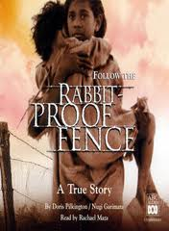
Review
Yes, I really enjoyed reading the Rabbit Proof Fence because whenever I started reading
it created suspense with in me and I did not wanted to leave and I wanted to keep reading.
This book provided much information about Australia and its history that I never knew about.
I also liked it because it was a non fiction book and I really like reading books that are true and a biography about someone’s life.

Slide 13
Recommendation
I would recommend this book to everyone but I would really recommend the Rabbit Proof Fence to the people who like to read non fiction stories or true journey.
I would like them to read this because this book is really a great book and story of three girls that have their longest walking journey of 1500 miles.
I say that this book is a really worthy book about the three sisters on the great journey back home along the Rabbit Proof Fence.

Slide 14
Vocabulary
Aborigines- the Australian Aborigine is the dark skin people who where the earliest natives of Australia.
Part of Speech: Noun
Quote: “ The Superintendent of the depot was also the Protector of Aborigines.” .(34 PILKINGTON)
Semi Nomadic- pertaining to be in the characteristics of nomads.
Part of Speech: adjective
Quote: “ As they came and settled, the people did not abandon their nomadic lifestyle entirely but adapted to one that was semi-nomadic. (35 PILKINGTON)
Leisurely- Acting or proceeding without a harsh feeling.
Part of Speech: adjective
Quote: “ By their manner one could of thought that the girls were taking a leisurely stroll in the bush.” (95 PILKINGTON)

Slide 15
Vocabulary (continue)
Perth- the capital city of the west Australia.
Part of Speech: noun
Quote: “The drive from Fremantle to Perth was comfortable” (57 PILKINGTON)
Banksia- A common gene of trees in Australia.
Part of Speech: noun
Quote: “ Yes they were making very good progress through the open banksia forest” (84 PILKINGTON)
Dormitory- A hotel or college of a thing that has private rooms for residents with good things
Part of Speech: noun
Quote: “ the staff member of the dormitories, conducted every morning without fail.” (64 PILKINGTON)

Slide 16
Bibliography
Pilkington,Doris. Rabbit Proof Fence. Australia: Nugi Garimara, 1996
Luke buckmaster.http://www.theguardian.com/film/australia- culture-blog/2013/dec/20/rabbit-proof-fence-rewatching- classic-australian-films - . Australia culture blog, October 12, 2014

